Slide 1
Probability
Yoobee Colleges

Slide 2
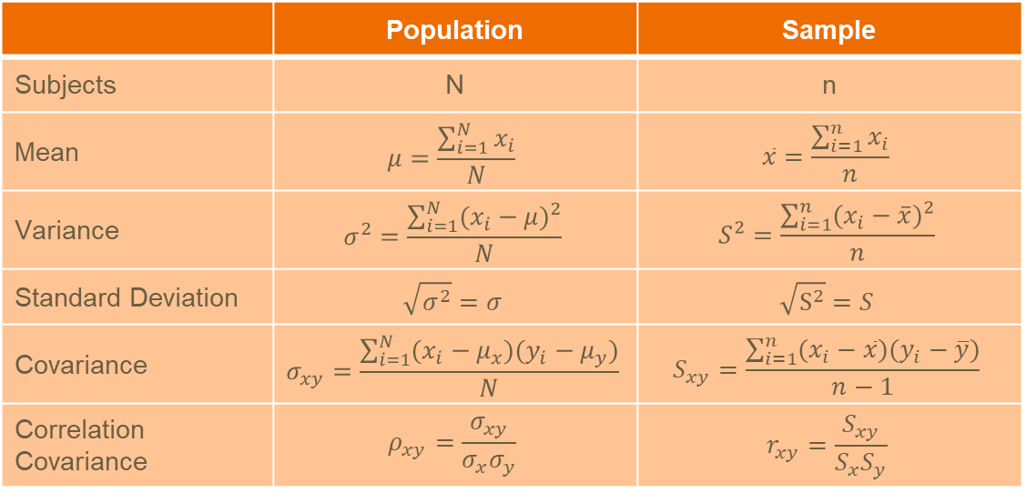
Statistics
 | Population | Sample
Subjects | N | n
Mean | $$μ=\frac{\sum_{i=1}^{N}{x_{i}}}{N}$$ | $$\overline{x}=\frac{\sum_{i=1}^{n}{x_{i}}}{n}$$
Variance | $$σ^{2}=\frac{\sum_{i=1}^{N}{{(x_{i}−μ)}^{2}}}{N}$$ | $$S^{2}=\frac{\sum_{i=1}^{n}{{(x_{i}−\overline{x})}^{2}}}{n}$$
Standard Deviation | $$\sqrt{σ^{2}}=σ$$ | $$\sqrt{S^{2}}=S$$
Covariance | $$σ_{xy}=\frac{\sum_{i=1}^{N}{(x_{i}−μ_{x})(y_{i}−μ_{y})}}{N}$$ | $$S_{xy}=\frac{\sum_{i=1}^{n}{(x_{i}−\overline{x})(y_{i}−\overline{y})}}{n−1}$$
Correlation Covariance | $$ρ_{xy}=\frac{σ_{xy}}{σ_{x}σ_{y}}$$ | $$r_{xy}=\frac{S_{xy}}{S_{x}S_{y}}$$

Slide 3

Probability
There are three boxes in one of which there is a diamond and I know where the diamond is. You selected one out of three boxes, and then I open an empty box from the left two, in this case, when I ask you if you want to exchange your box with the box in my hand, what will you choose?

Slide 4
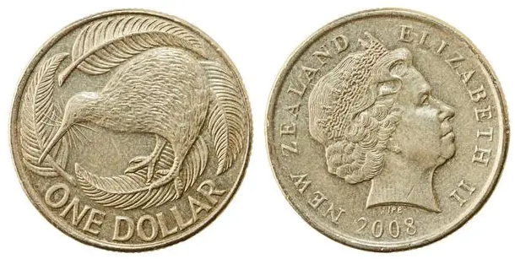
Probability
Probability = Likelihood
Heads?
Decimal
0
0.5
1
Fraction
0
1/2
1
Percentage
0%
50%
100%

Slide 5
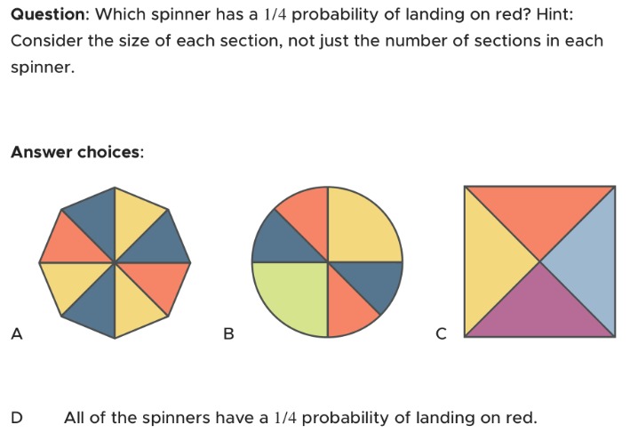
Exercise
Notes:
D

Slide 6
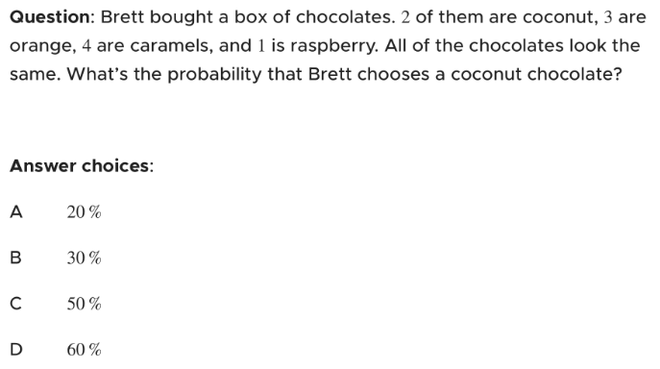
Exercise
Notes:
A

Slide 7
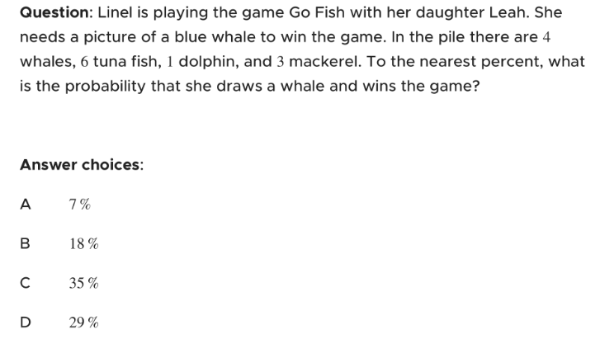
Exercise
Notes:
D

Slide 8
Q/A?

